Slide 1
Welcome to Year 1
Parents Curriculum Meeting
Autumn 2024

Slide 2
A quick word…
Thank you for your patience over last few weeks especially at the start of the day and home time.
The children have settled in brilliantly.

Slide 3
Expectations
We expect children to take responsibility and make their own decisions.
Come into school independently and take responsibility for putting away belongings such as book bag, water bottle etc.

Slide 4
Look after their own clothes and PE kit.
PLEASE make sure everything is labelled with your child’s name!

Slide 5

How do we teach reading?
We teach early reading using a synthetic phonics programme called, 'Little Wandle Letters and Sounds Revised’​
This is a rigorously structured reading programme​
You can find out more about Little Wandle using the following web address: ​
https://www.littlewandlelettersandsounds.org.uk/resources/for-parents/

Slide 6
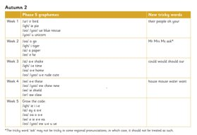
How do we teach reading?
In year 1 the children will receive a daily phonics lesson ​
The phonics lesson will teach the children letters and the sounds they make​
The phonics lesson will teach the children how to spell tricky words​
A handout showing the pace and progression of teaching is available

Slide 7


A fluent reader enjoys reading
An early love of reading is the strongest indicator of future academic success
We want the children to LOVE reading
If we want children to read, they must enjoy It

Slide 8


How do we make sure that the children love reading?
We match the books the children take home (reading practice books) very closely to the children’s learning
We minimise the cognitive load
We make sure that the child does not struggle
We make sure that the child is successful and understands what they are reading
We make sure that the child is practising reading fluently

Slide 9
Why do we need to match phonic knowledge to reading books so carefully?
Put you in the position of reception child
You have been learning lots of letters and sounds for 2 terms
You are doing so well
You love reading
You can read the following…
What happens if I give you a more challenging book?

Slide 10
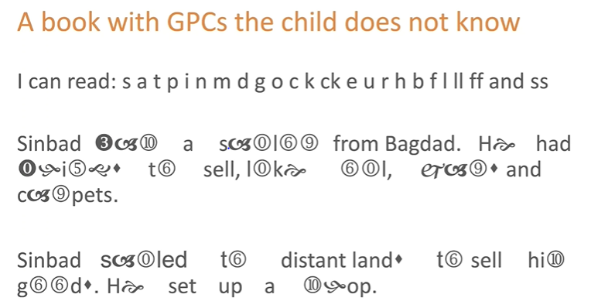

Slide 11
What is the impact?
Cognitive load
Enjoyment
Comprehension
Motivation

Slide 12


Your child will bring home…
A reading practice book
They will be able to read this book automatically
This is a book which will enable your child to ‘show off’ their reading
This means that your child will love reading and will expect what they read to be fun and make sense to them
Please remember these messages if you find yourself thinking, ‘Is this book too easy?’
A sharing book
This is a book chosen by your child for you to read to them
Your child is not expected to read this book
This book is all about fun and enjoyment

Slide 13


Our Books
Books will be sent home on Wednesdays
Books must be returned to school on Mondays
Please take special care of our brand new reading books so that all the children can enjoy them

Slide 14
Progress
Once your child has finished the Little Wandle reading programme their reading fluency and comprehension will be assessed
Your child may then bring home a colour book banded book
Again, this is very closely matched to the child's reading ability
All children progress at different rates
It is essential that the children do not view their progress as a race through the book bands
Phonics screening check

Slide 15
Learning Expectations
Each child will be encouraged to work towards the appropriate learning expectations for the level at which they are working. The following slides contain standard expectations for Year 1. We will aim to show you how they will achieve these.
Daily phonics
Daily English (talk for writing)
Daily Maths

Slide 16

Learning Expectations
I can write phrases and statements/sentences.
I use full stops in my writing.
I use a capital letter at the start of my writing.
I can write clearly so that people can read my writing.
I can write a story with a beginning and at least one event.
I try and use some simple descriptive words.
Letters are usually clearly shaped and correctly orientated.
I write my whole name with correct letter formation.
I can use the Grammar I have learned correctly.
I can use the new handwriting scheme (taught weekly).

Slide 17
Maths Learning Expectations
Count within 100, forwards and backwards, starting with any number
Reason about the location of numbers to 20 in comparison to one another using the language of more/less than, greater than and equal to
Develop fluency in addition and subtraction facts within 10
Count forwards and back in multiples of 2, 5 and 10, beginning with any multiple
Count forwards and back through the odd numbers
Compose numbers to 10 from 2 parts with different representations
Partition(split) numbers to 10 into parts with different representations
Recognise odd and even numbers
Read, write and interpret equations containing addition, subtraction and equals signs and relate to real life contexts
Recognise common 2D and 3D shapes
Compose 2D and 3D images from smaller common shapes eg use triangles and squares to compose a rocket
Tell the time to the o‘clock and half past

Slide 18
Ways you can help
Help your child learn at home by reading together
Mistakes make our brains grow bigger so it is fine to make mistakes.
Use the computer to further their learning using websites such as ictgames.co.uk and topmarks.co.uk
Whenever your child is writing, encourage them to use the correct letter formation and to check the size of their letters.

Slide 19

Working together
Your child is important to us.
We want them to be happy in school and make the best
possible progress they can.
This year we are encouraging all children to be brave with their learning.

Slide 20

Any questions?
Please let us know and we will be more than happy to talk to you.

