Slide 1

WIS QUIZ

Slide 2
How can everyday materials change their shape?
Notes:
Breaks, tears, push, pull, twist ,squash, bend, stretch

Slide 3
What animals need to survive?
Notes:
food, water, shelter and safety.

Slide 4
How do humans change as they grow?
Notes:
height, size and body parts

Slide 5
How do we know if something is alive?
Notes:
moves, breathes, grows, needs food and water, reproduces and responds to surroundings

Slide 6

What does a plant need to grow and stay healthy?
Notes:
water, light and a suitable temperature

Slide 7
Name a material or object that can be stretched.
Notes:
Elastic band
Balloon
Lycra fabric
Stretchy hair bobble

Slide 8
Name a material or object that can be squashed.
Notes:
Sponge
Foam
Cotton wool
Playdough

Slide 9
Name a material or object that cannot be twisted.
Notes:
Metal
Brick
Wood
Glass

Slide 10
What are the basic needs of animal and human survival?
Notes:
Food, shelter

Slide 11
What do we need to stay healthy?
Notes:
Exercise, balanced diet, sleep, good hygiene

Slide 12
What is a food chain?
Notes:
A food chain shows how living things get their food and energy from other living things.

Slide 13
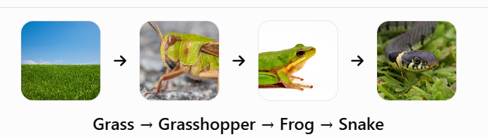
What does this food chain show?
Notes:
The arrow means “is eaten by” or shows where energy goes. The grass is eaten by the grasshopper, the grasshopper is eaten by the frog etc.

