Slide 1

WIS QUIZ

Slide 2
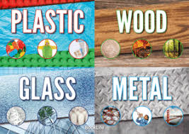
Name some everyday materials
Notes:
Object, material, wood, plastic,glass, metal, water, rock, brick,paper, fabric, elastic,foil, card, cardboard, rubber, wool, clay

Slide 3
Name the properties of everyday materials
Notes:
Hard,soft,strectchy, stiff,bendy,floppy,waterproof,absorbent, rough,smooth,shiny,dull,see through, not see through

Slide 4
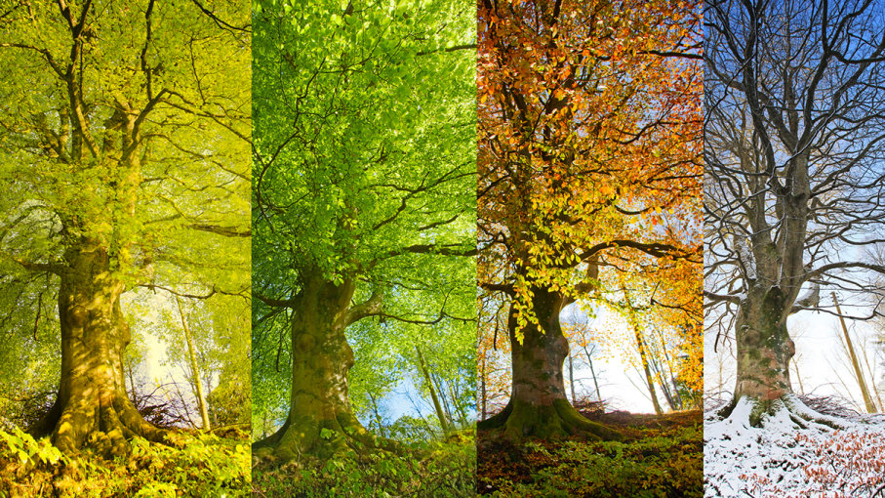
Name the seasons
Notes:
Spring Summer Autumn Winter

Slide 5
What do we call a meat eater?
Notes:
Carnivore

Slide 6
What do we call a plant eater?
Notes:
Herbivore

Slide 7
What do we call a plant and meat eater?
Notes:
Omnivore

Slide 8
How many senses have we got?
Notes:
5

Slide 9
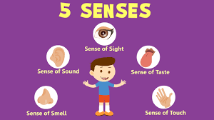
Characteristics
What do we use our senses for?

Slide 10
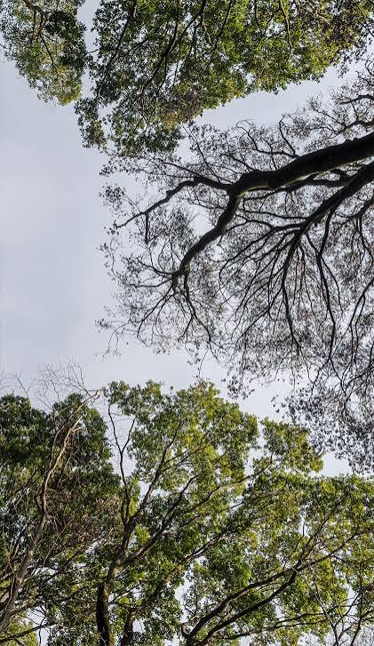
What do we call trees that shed their leaves?
Notes:
Deciduous

Slide 11
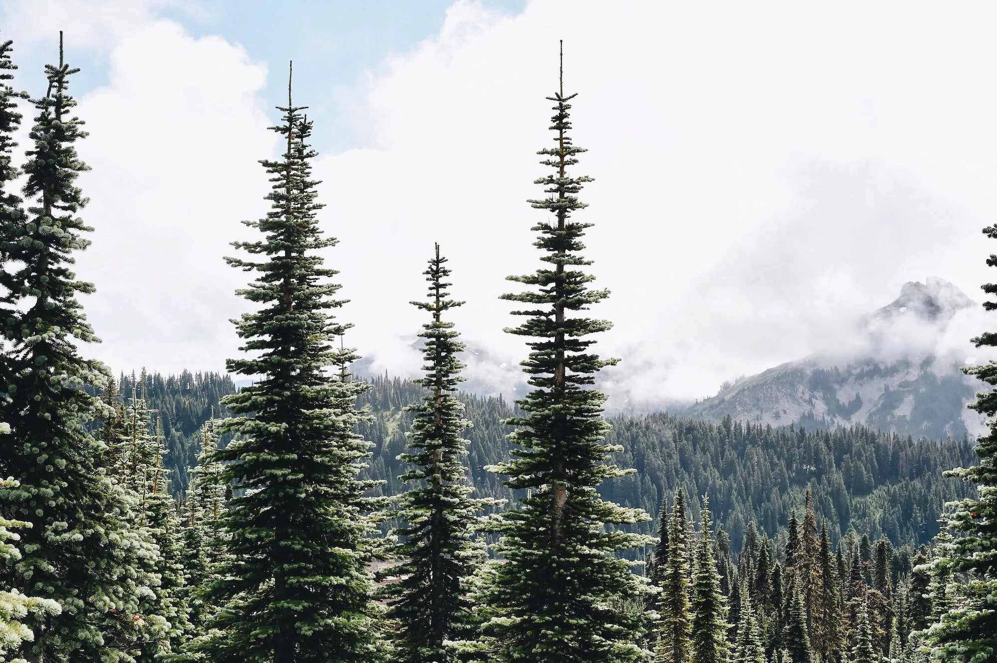
What do we call trees that keep their leaves all year round?
Notes:
Evergreen

Slide 12
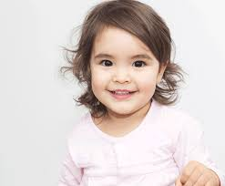
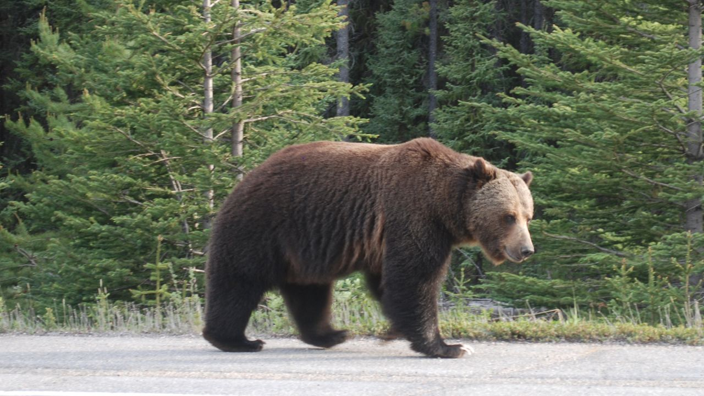
What are the characteristics of mammals?
Notes:
Fur, hair, give birth to live babies, warm blooded, feed their babies milk

Slide 13
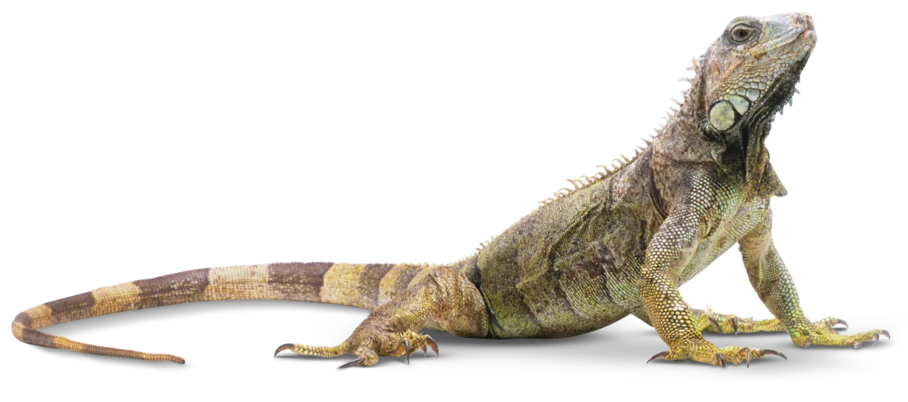
What are the characteristics of reptiles?
Notes:
Have scales, cold blooded, usually lay eggs

Slide 14
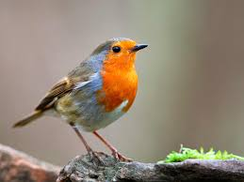
What are the characteristics of birds?
Notes:
Have feathers and wings, lay eggs, warm blooded

Slide 15
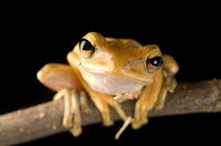
What are the characteristics of amphibians?
Notes:
Live on land and water, cold blooded, warm if in the warmth, moist skin, no fur or hair, breath with lungs and gills, lay many eggs

Slide 16
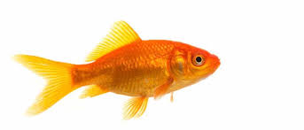
What are the characteristics of a fish?
Notes:
Breath under water using gills not lungs, lay many eggs, live in water, cold blooded, have scales and fins

Slide 17
Name a carnivore.
Notes:
Lions, tigers, sharks, hyenas, seals

Slide 18
Name a herbivore.
Notes:
Horses, rabbits, cows, deer

Slide 19
Name an omnivore.
Notes:
Dogs, pigs, bears, humans, gorillas, squirells

