Slide 1
Welcome to Year 2
Class 5 Mrs Mitchell & Class 6 Miss Bartlam

Slide 2

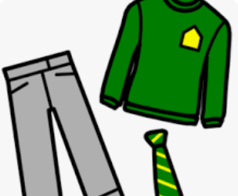
General Expectations
We encourage the children to care for their belongings and be responsible for them
Please make sure that jumpers etc. are labelled
Please check children's book bags for letters
Please ensure reading books and diaries are brought into school daily
Please make sure that the children have appropriate clothing for the weather.

Slide 3

The School Day
We start the day by ‘checking in’
English, maths and phonics lessons are on most days
Science, history, geography, RE, computing, PE, music and art and design also take place
To find out what we are teaching please see our ‘What we are learning’ document on the website
We sometimes run focus/booster/friendship groups for additional support or to provide an extra challenge

Slide 4
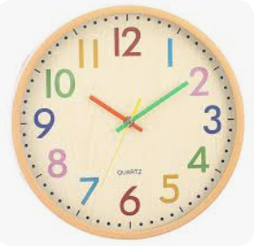
A Typical Day
8:45am Children come in, put their things away and start their morning task.
8:55am Register, look at the day’s timetable together.
9:00am Phonics
9:30am Maths
10:20am Playtime (snack)
10:35am English
11:30am Handwriting
12:00pm Lunchtime
1:00pm Assembly
1:20pm Foundation subject (art, history etc.)
2:20pm Playtime
2:30pm Whole Class Reading
2:50pm Mastering Number
3:10pm Story Time
Notes:
***

Slide 5

PE
PE is on Tuesday and Thursday
Please make sure that your child has their PE kit in school every day.
They will need shorts/leggings or jogging trousers.
Please make sure that earrings have been taken out or covered with a plaster.
Please make sure that hair is tied back.

Slide 6




English in Year 2

Slide 7


English Lessons
English learning objectives are taught through an engaging text.
This keeps the learning fun for the children.
All the books we use are on the website.

Slide 8


Marking
Marking symbols are the pictures we use with the children to represent different elements of writing.
This symbol is used in the children’s books to show that we have talked to your child about their writing.

Slide 9
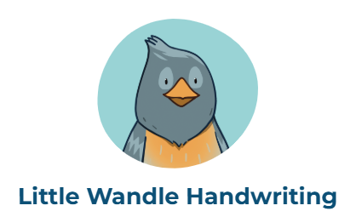
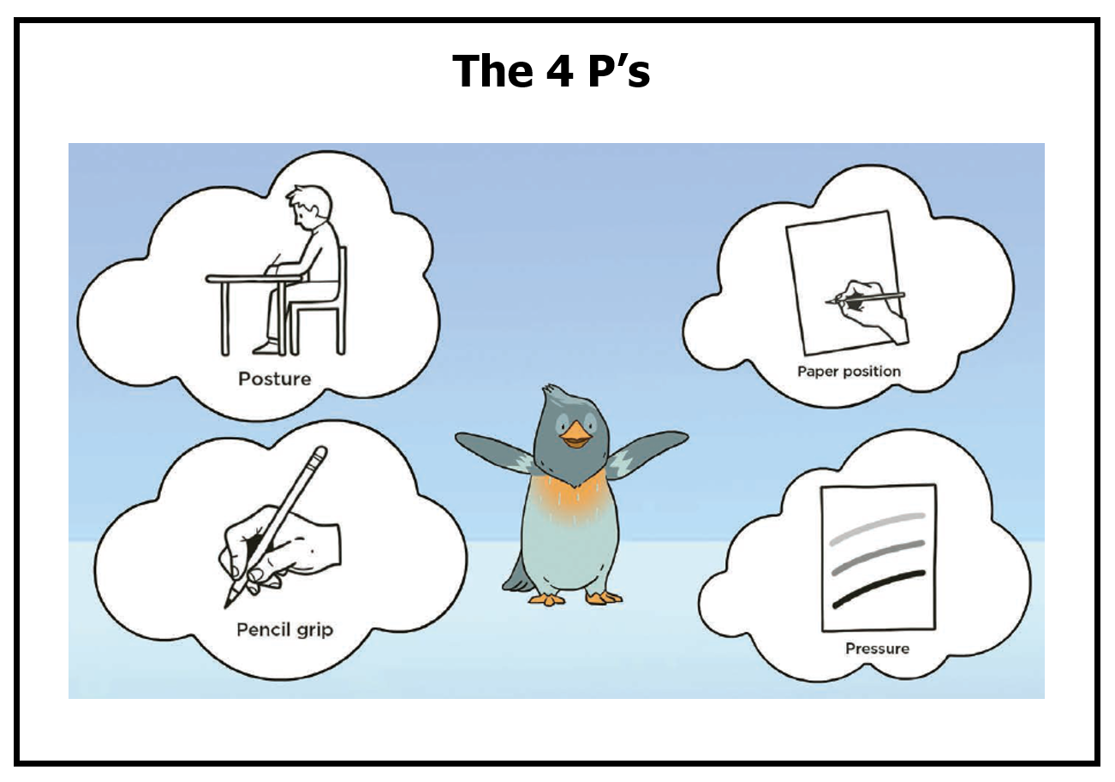
Handwriting
By the end of Year 2, the children should be writing letters and numbers of the correct size and orientation without any reversals.
We aim for each child to start to join neatly by the end of the year.

Slide 10

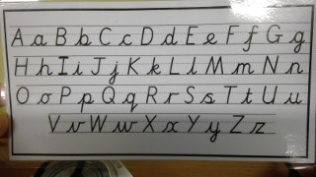
Spellings
We are currently finishing off the Little Wandle Phonics programme and will then move to the spelling programme.
We will explore key spelling rules across the programme.
Each half term we will send out a list of tricky word spellings for you to work on with your child at home.

Slide 11
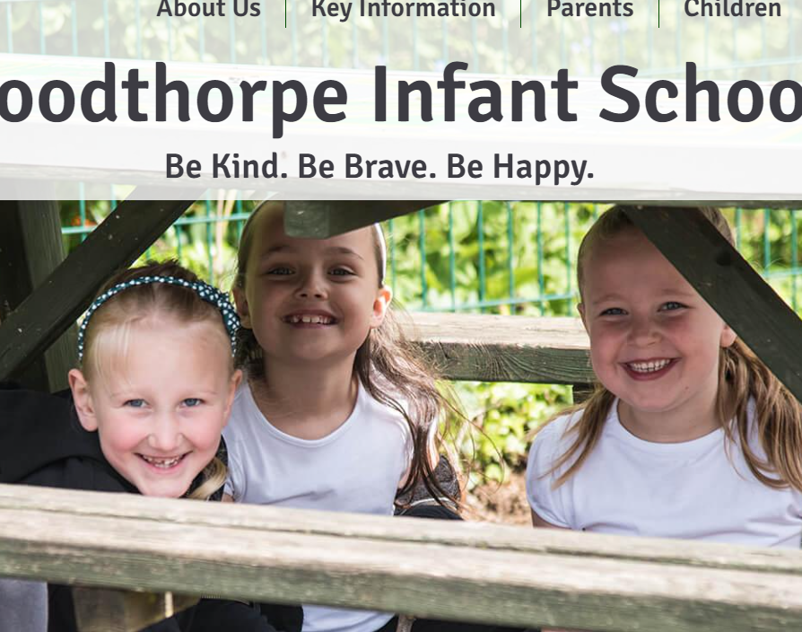

The Website
We will let you know what we’ve been working on over the week through Class Dojo
This curriculum presentation and what we are learning will be on the year group page on the website

Slide 12

Maths in Year 2

Slide 13
Maths
The children are taught that maths is fun and mistakes help our brains grow.
We focus on fluency and mastery.
We ensure that the children can reason and solve problems using their knowledge of the number system up to 100.
A deep understanding of the number system leads to confidence and a love of maths.
We avoid time pressures and always ask the children to explain how they know something.
Please encourage your child to feel confident about maths.

Slide 14
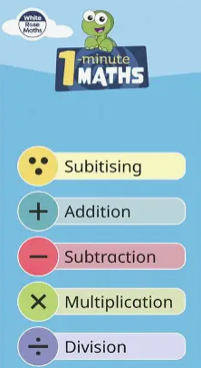
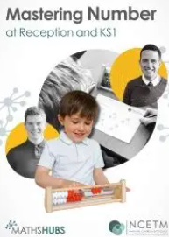

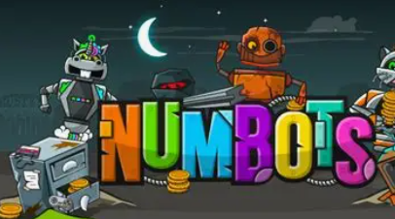
White Rose Maths
Mastering Number
Numbots
1 Minute Maths app
There will be a maths information evening later in the year

Slide 15


Reading in Year 2

Slide 16

How do we teach reading?
We teach reading in a variety of ways.
One of the ways we teach reading is through a synthetic phonics programme called, 'Little Wandle Letters and Sounds Revised’.
This is a rigorously structured reading programme
You can find out more about Little Wandle using the following web address:
https://www.littlewandlelettersandsounds.org.uk/resources/for-parents/
The website has useful information for parents and shows you how to use ‘pure sounds’.

Slide 17


A fluent reader enjoys reading
An early love of reading is the strongest indicator of future academic success.
We want the children to LOVE reading.
If we want children to read, they must enjoy It.

Slide 18


How do we make sure that the children love reading?
We match the books the children take home (reading practice books) very closely to the children’s learning.
We minimise the cognitive load.
We make sure that the child does not struggle .
We make sure that the child is successful and understands what they are reading.

Slide 19


Your child will bring home…
A reading practice book
They will be able to read this book automatically.
This is a book which will enable your child to ‘show off’ their reading.
This means that your child will love reading and will expect what they read to be fun and make sense to them.
Please remember these messages if you find yourself thinking, ‘Is this book too easy?’
A sharing book
This is a book chosen by your child for you to read to them.
Your child is not expected to read this book.
This book is all about fun and enjoyment.

Slide 20


Our Books
Books will be sent home on Wednesdays or Thursdays.
Books must be returned to school on Wednesdays.
Please take special care of our reading books so that all the children can enjoy them.

Slide 21

Progress
Once the children have finished the Little Wandle reading scheme their reading fluency and comprehension is assessed.
The children may then be moved onto a colour book banded book.
Again, this is very closely matched to the child's reading ability.
All children progress at different rates.
It is essential that the children do not view their progress as a race through the book bands.
Remember we want the children to love reading.

Slide 22

Whole Class Reading
The children also receive three whole class reading sessions per week.
This involves reading a text, supported by the teacher.
We work on:
Prediction – predicting what might happen next.
Clarification – clarifying what words mean.
Questioning – answering questions using evidence from the text.
Summarising – summing up what we have read in a few sentences.
A note explaining the skill we have worked on and the text we have read will put onto Dojo each week.
The children may also take part in a small group reading practice session.

Slide 23
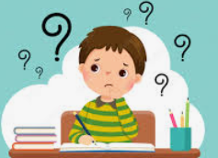
Homework in Year 2

Slide 24
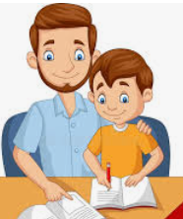


Homework
We do not send work home regularly. However, we encourage you to read daily with your child and practise spellings.
We will occasionally send home a specific task that may link to the learning they are doing.
If your child needs a little extra help with a particular skill or concept, we may send home some individual tasks which we will discuss with you .

Slide 25

Assessment in Year 2

Slide 26

Assessment
We encourage the children to be reflective learners, identifying for themselves what they need to improve/practise as they learn.
In May, children will undertake optional SATs - standardised assessment tests. These are nothing to worry about and are approached with a lowkey attitude within school. There is no need to do anything differently in the run up to SATs.
Information from both informal and formal assessments will be shared throughout the year at parents evenings and in the end of year report.
If you are concerned about your child's progress or there is a change in your circumstances, do come and chat with us.

Slide 27


Remember…
We want to support you as much as we possibly can.
Please do let us know if you have any worries or concerns. We will always listen!

Slide 28


