Slide 1
Welcome to year 1!
Year 1 curriculum presentation 2026
Notes:
Both introduce

Slide 2
What your child needs
Please label everything!
Water bottle
Book bag
PE kit (indoor and outdoor)

Slide 3
What is year 1 like?
More structured learning
Developing independence
Learning to listen, concentrate and follow instructions
Building resilience and confidence
Lots of opportunities for practical, play-based and active learning

Slide 4

What we learn
Notes:
Mastering number,, handwriting

Slide 5
How do we teach reading?
We teach early reading using a synthetic phonics programme called, 'Little Wandle Letters and Sounds Revised’​
This is a rigorously structured reading programme​
You can find out more about Little Wandle using the following web address: ​
https://www.littlewandlelettersandsounds.org.uk/resources/for-parents/

Slide 6

How do we teach reading?
In year 1 the children will receive a daily phonics lesson ​
The phonics lesson will teach the children letters and the sounds they make​
The phonics lesson will teach the children how to spell tricky words​

Slide 7


A fluent reader enjoys reading
An early love of reading is the strongest indicator of future academic success
We want the children to LOVE reading
If we want children to read, they must enjoy It

Slide 8


How do we make sure that the children love reading?
We match the books the children take home (reading practice books) very closely to the children’s learning
We minimise the cognitive load
We make sure that the child does not struggle
We make sure that the child is successful and understands what they are reading
We make sure that the child is practising reading fluently

Slide 9
Why do we need to match phonic knowledge to reading books so carefully?
Put you in the position of reception child
You have been learning lots of letters and sounds for 2 terms
You are doing so well
You love reading
You can read the following…
What happens if I give you a more challenging book?

Slide 10
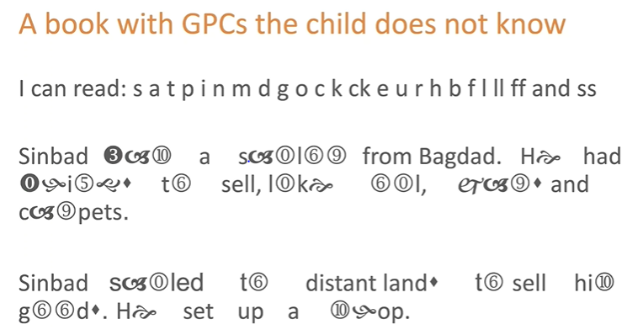

Slide 11
What is the impact?
Cognitive load
Enjoyment
Comprehension
Motivation

Slide 12


Your child will bring home…
A reading practice book
They will be able to read this book automatically
This is a book which will enable your child to ‘show off’ their reading
This means that your child will love reading and will expect what they read to be fun and make sense to them
Please remember these messages if you find yourself thinking, ‘Is this book too easy?’
A sharing book
This is a book chosen by your child for you to read to them
Your child is not expected to read this book
This book is all about fun and enjoyment

Slide 13
Progress
Once your child has finished the Little Wandle reading programme their reading fluency and comprehension will be assessed
Your child may then bring home a colour book banded book
Again, this is very closely matched to the child's reading ability
All children progress at different rates
It is essential that the children do not view their progress as a race through the book bands
Phonics screening check

Slide 14
Writing
Writing sentences independently
Capital letters, finger spaces and full stops
Phonic spelling
Handwriting
Vocabulary
Story writing
Non-fiction writing
Proofreading/editing simple writing
Notes:
ideas and confidence in writing are just as important as spelling accuracy. – taught through English lessons, handwriting sessions, spellings

Slide 15
maths
Number and place value
Addition and subtraction
Fractions
Shape
Measurement
Position and direction
Time
Money
Notes:
Concrete – pictorial – abstract
Children need to be able to explain their thinking

Slide 16

Working together
Your child is important to us.
We want them to be happy in school and make the best
possible progress they can.

Slide 17
Ways to help at home
Read
Spellings/ handwriting
Maths games (e.g., numbots)
Encourage independence and resilience.

Slide 18

Thank you!
Any questions?

