Slide 1

Welcome to our Foundation Stage
Notes:
Suzi

Slide 2
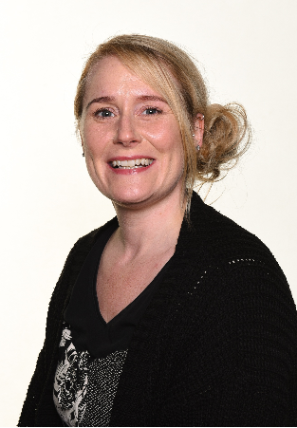
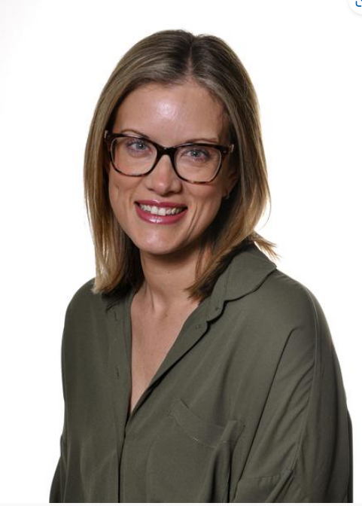
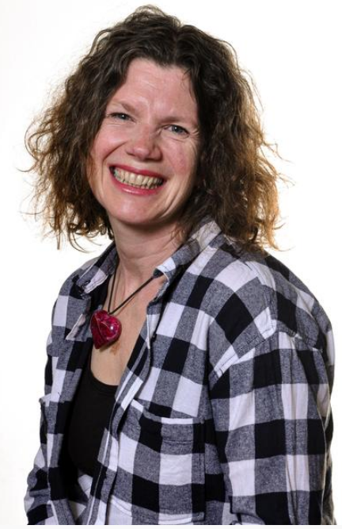
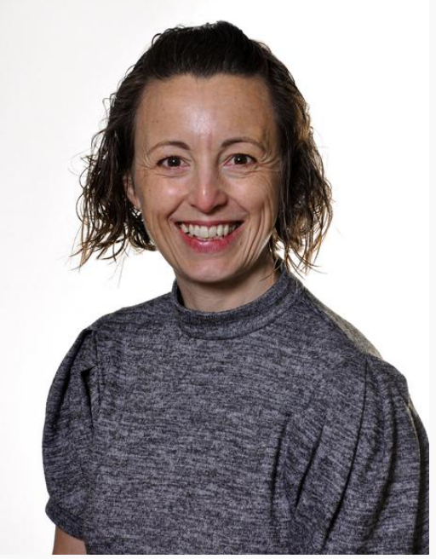
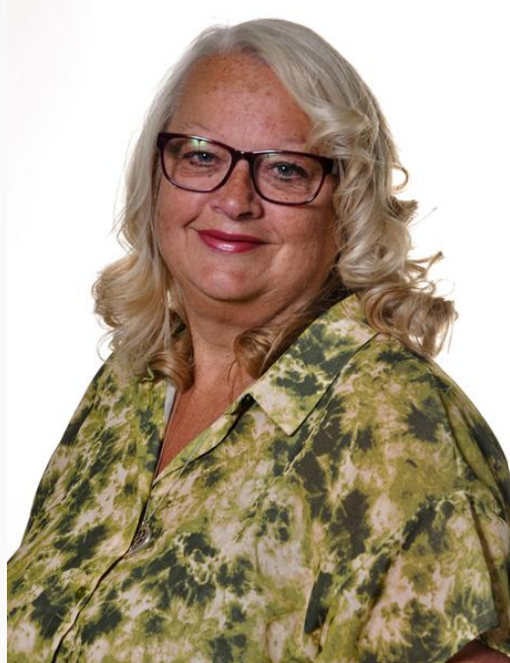
Our staff
Class 1 – Brave Bears
Class 2 – Busy Bees
Mrs Burton
Mrs Bucknall
Miss Maule
Mrs Hardy
Mrs Offord
Notes:
Suzi

Slide 3
Doors to the classroom open at 8.45am. School finishes at 3.30pm.
Please inform staff if someone new is collecting your child.
Every child has their own peg to store their coat.
We have limited storage space in the classroom so please do not send in any bags or unnecessary personal belongings.
Notes:
Queuing system at school door. Suzi

Slide 4
What does my child need for the school day?
Uniform
Warm coat
Water bottle
Wellies
Lunch box (if bringing own lunch from home)
We kindly request that children do not bring any toys from home to school.
**Don’t forget to label your child’s belongings with their name**
Notes:
Discuss book bags / changing for PE – Building independence as the year progresses. Ask parents to continue to support children to dress and undress themselves.
Naomi

Slide 5

Children can use the toilets whenever they need to.
During carpet times we encourage children to put up their hands to ask before they go.
We will help children with fastening on trousers.
If your child is prone to accidents please send them with a change of clothes and wipes to be kept on their peg.
If you have any concerns about toileting please speak to us at the end of the meeting.
Notes:
Naomi

Slide 6
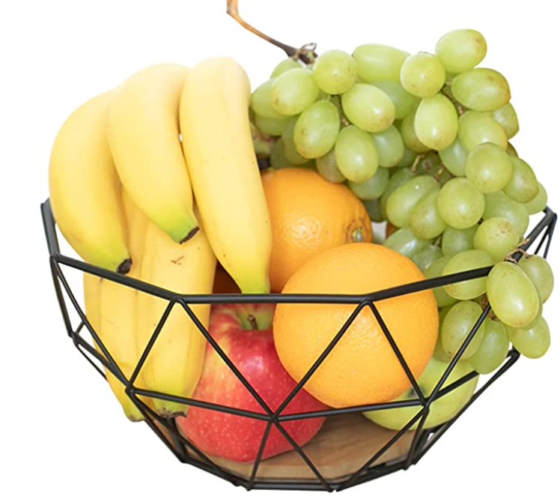
Snack
Fruit and vegetables are provided free for all children.
Children can have free semi-skimmed cows milk up to their 5th birthday. You can then pay if you wish to continue.
Snack time in Foundation happens during free-flow; children can choose when they would like something to eat or drink.
Children have access to their water bottles throughout the day.
Lunch:
Children eat together in the school hall.
After eating the children use the large school playground to access OPAL provision.
All reception children are eligible for a free school dinner.
Notes:
Naomi

Slide 7

Behaviour
Encouraging children to make the right choices
Restorative justice
Friday assembly
Notes:
At Woodthorpe we encourage the children to adopt our school values be kind, be brave, be happy. We expect children to be kind to each other in their words and actions. To help them with this, we encourage the children to recognise the impact their behaviour has on others. When their behaviour has hurt others, we spend time with all involved talking through what has happened, how everyone is feeling and how relationships can be restored. More details of our approach to behaviour management can be found on our website.
Positive attitudes to behaviour and learning are recognised and celebrated in our whole school assembly on Fridays. While your child is at Woodthorpe they are encouraged to be brave – both in their learning and in their relationships with others. Amongst other things, this means having a go when we’re unsure, talking to someone new, and not being afraid to make mistakes as mistakes help us learn. Each week the school also recognises anyone who has shown outstanding bravery during our Friday assembly. If your child has succeeded in something out of school or been particularly brave do let the school office know so we can celebrate with them and share this in our weekly newsletter. Naomi

Slide 8
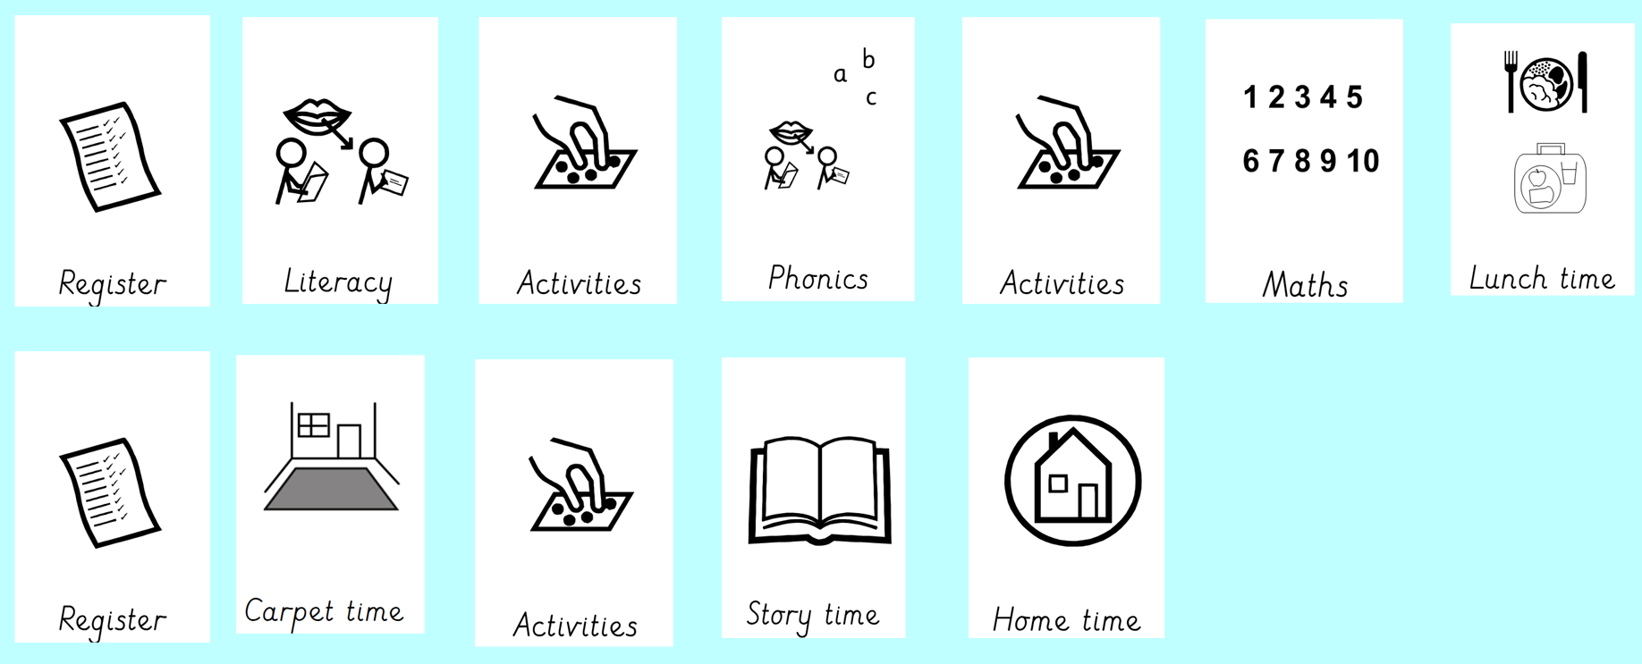
Daily Timetable
Notes:
Mix of whole class/small group/adult led, child initiated… Suzi

Slide 9


Other activities….
Wednesday
Friday
Notes:
Suzi

Slide 10

What is the Early Years Foundation Stage?
The Early Years Foundation Stage (E.Y.F.S.) is the stage of education for children from birth to the end of the Reception year.
It is based on the recognition that children learn best through play and active learning.
The seven areas of learning in the EYFS are interlinked, with each one supporting and strengthening the others to build a holistic foundation for children’s development and learning.
Notes:
Suzi

Slide 11

Our Curriculum
Sequenced carefully
Knowledge and skills build over time
Lots of opportunities to practice and revisit.
Adult led sessions, opportunities in provision and independent challenges
Reflection time

Slide 12
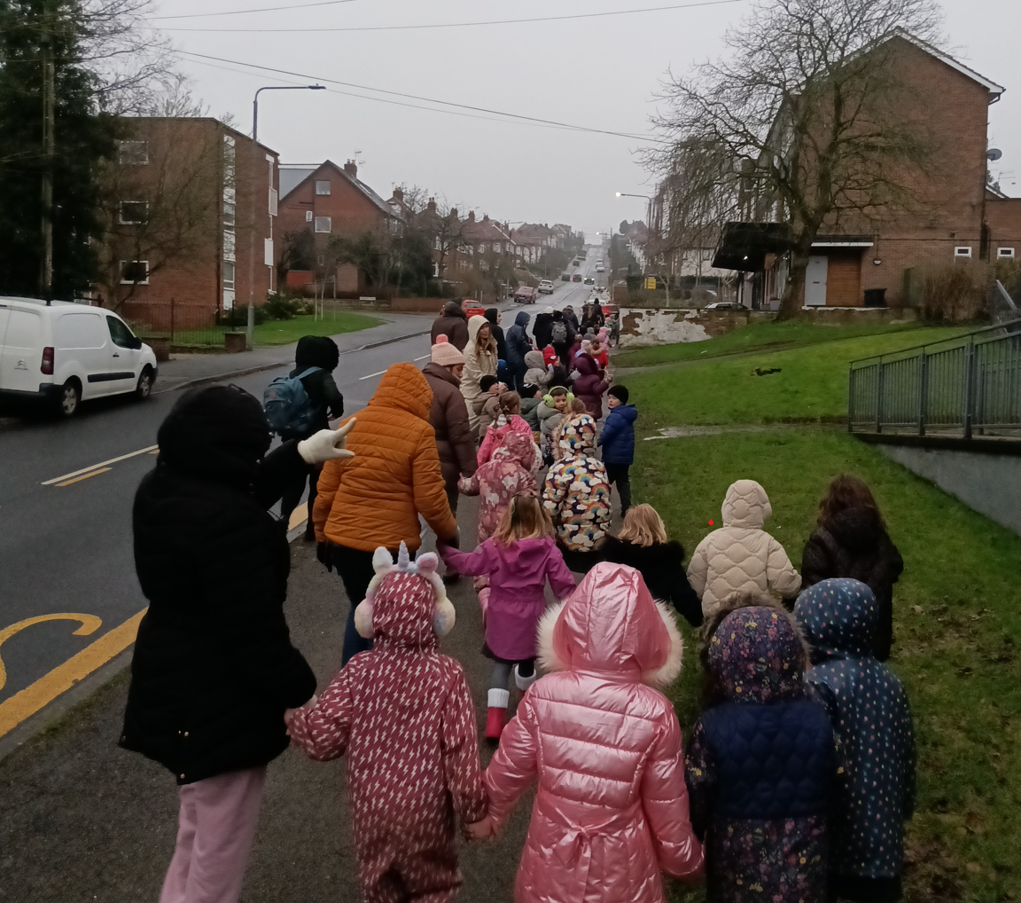
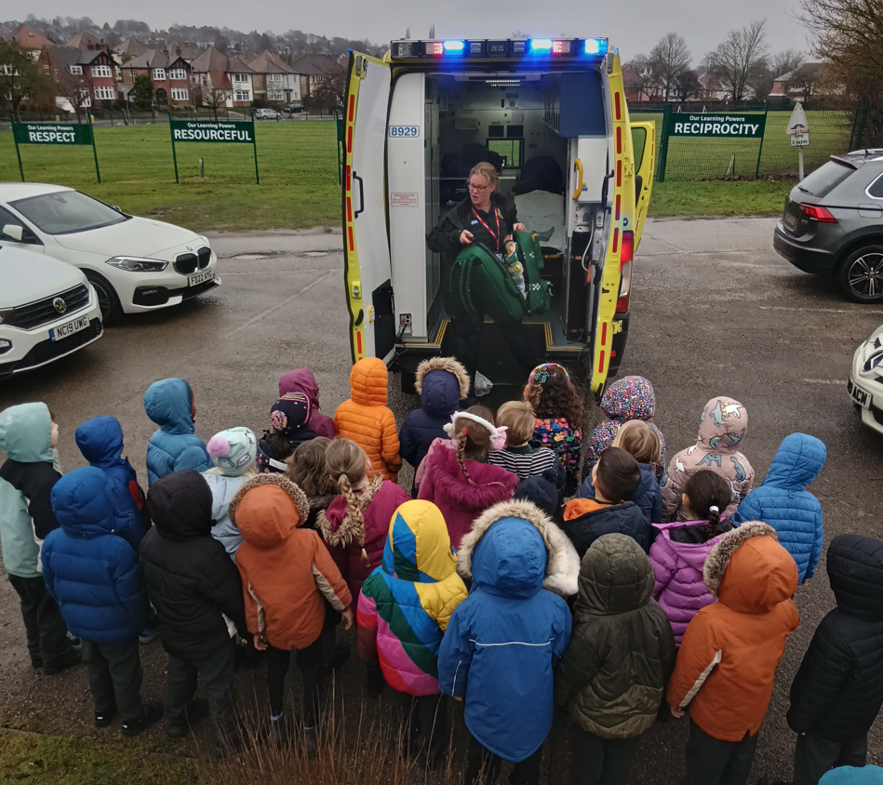
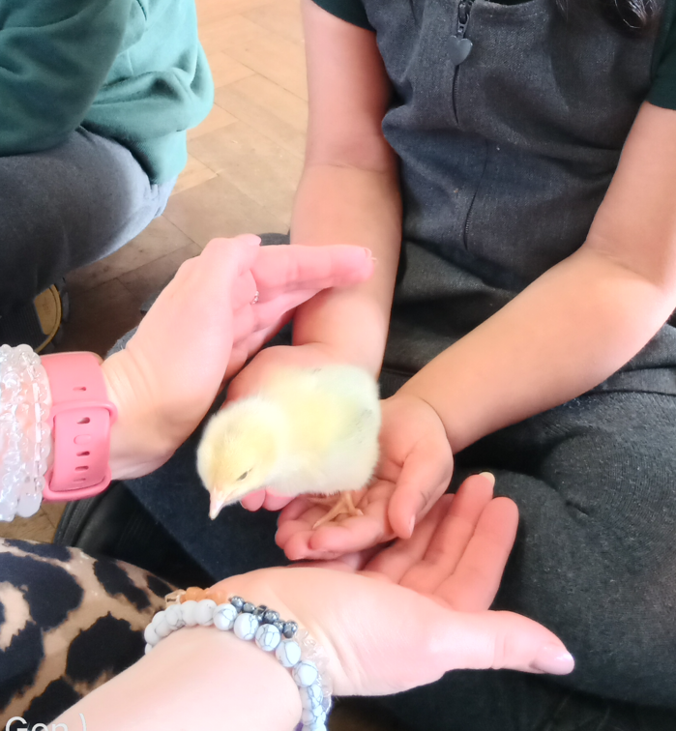
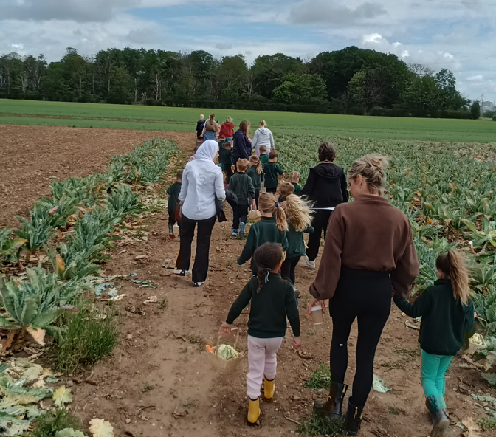
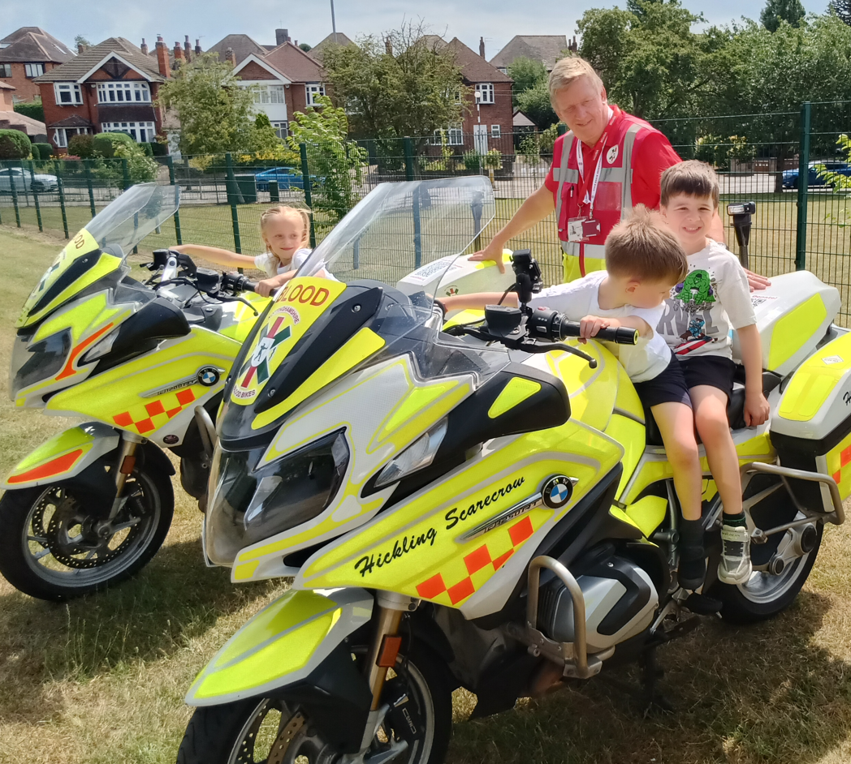
Trips and Workshops

Slide 13
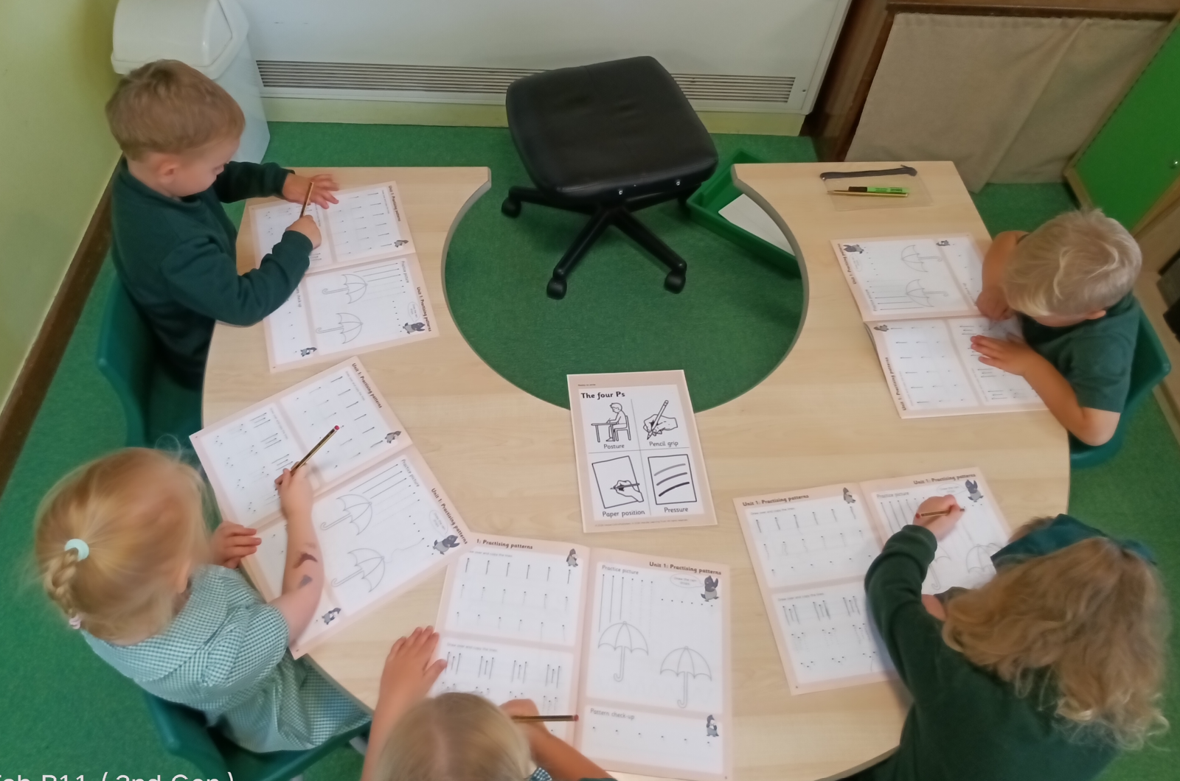

How do we teach writing?
We build the foundations first – children develop their posture, pencil grip, control, pressure and fine-motor skills ready for writing.
We begin with patterns – children practise pre-writing movements to develop control, flow and confidence.
We teach letter formation explicitly – adults model exactly where each letter starts and the direction it travels.
Letters are taught in families – children learn letters with similar formation patterns together, helping to reduce cognitive load and develop consistent movements.
We use Little Wandle formation phrases – memorable phrases help children remember how to form each letter correctly and link handwriting with phonics.
Children practise in different ways – including air writing, tracing and supported practice before applying their learning independently.
Notes:
Teaching love of writing and love of story
Leads from mark making through to sentence writing. Naomi

Slide 14

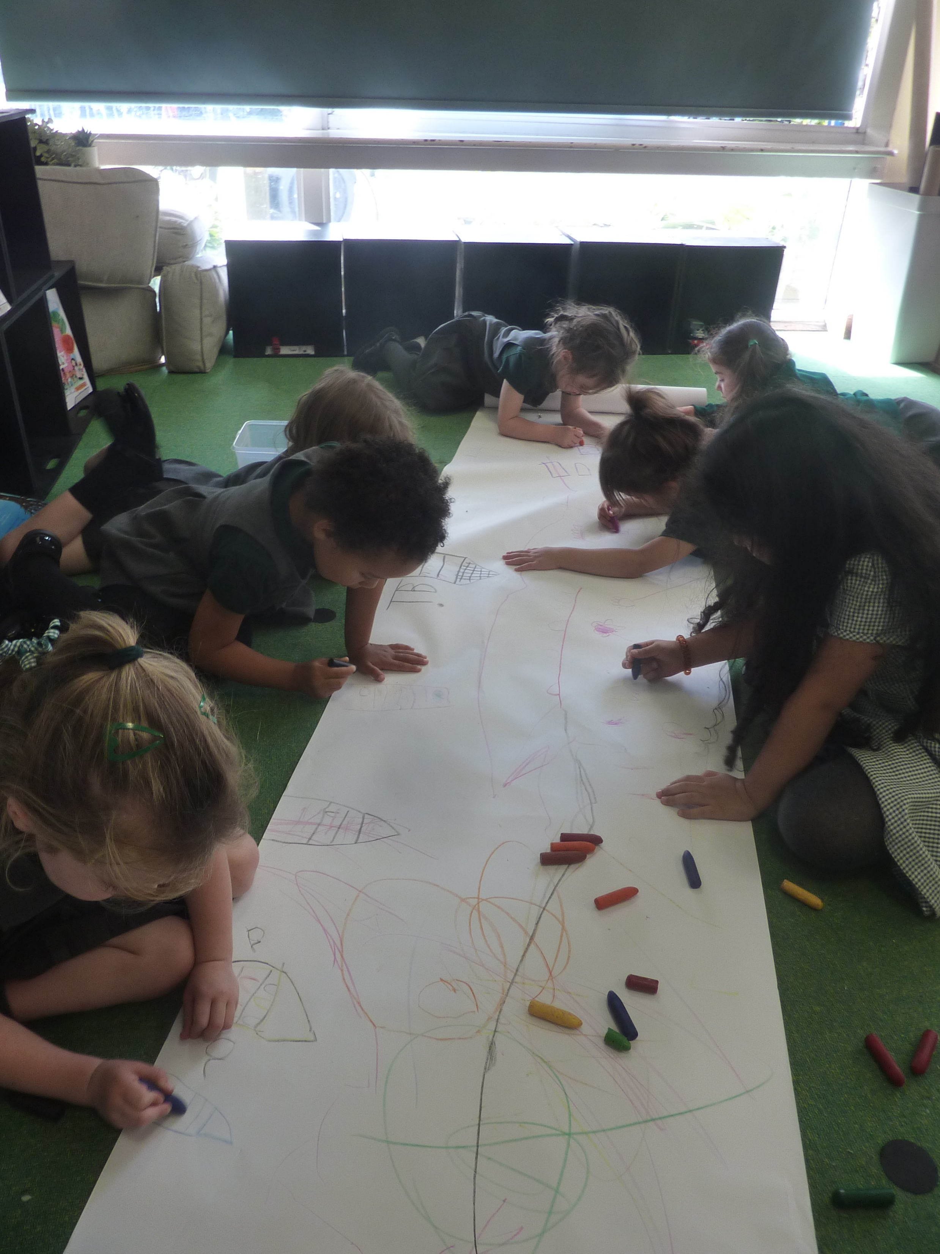

How do we teach writing?
Listening to and enjoying stories
Learning new vocabulary linked to the text
Sharing imaginative ideas in response to the text
Teacher led modelling of recording ideas along with a special ‘code’ – this could be a word or sentence.
The opportunity to record our own ideas through drawing and writing.
Our writing symbols:
Notes:
Teaching love of writing and love of story
Leads from mark making through to sentence writing. Naomi

Slide 15

How do we teach reading?
We teach early reading using a synthetic phonics programme called, 'Little Wandle Letters and Sounds Revised’
This is a rigorously structured reading programme
Further information about how to support your child with reading will be given at our Phonics Presentation on Monday 28th September at 6.00pm.
Notes:
Naomi

Slide 16

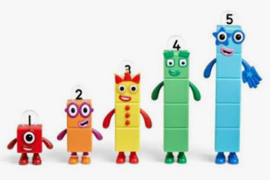
How do we teach Maths?
We build strong number sense – developing a secure understanding of numbers and what they represent.
We learn through practical activities – using objects, fingers, dice, games and everyday experiences.
We focus on subitising – recognising small amounts without needing to count each object.
We explore counting and cardinality – understanding that the last number counted tells us how many there are.
We develop a deep understanding of numbers to 10 – exploring how numbers are made up and how they relate to one another.
We explore composition – finding different ways to make and partition numbers.
We develop mathematical language – talking about more, less, equal, greater, fewer and how we know.
We encourage children to explain their thinking – developing confidence to share and discuss mathematical ideas.
We apply our learning through play and everyday opportunities – solving problems and using maths in meaningful contexts
Notes:
Naomi

Slide 17
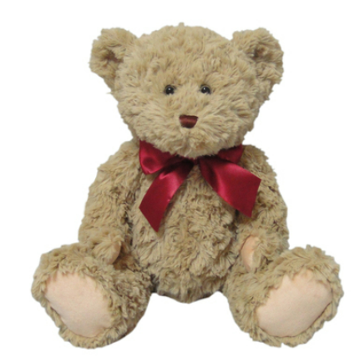


Everywhere Bear
Everywhere Bear will be visiting our families each week.
Notes:
Choose a book on Friday. Parents bring a bag to take home. Suzi

Slide 18

ClassDojo
Communication tool for School and Parents
We will update our dojo page weekly with photographs of our activities and experiences in the classroom.
Parents can send private messages to teachers, we aim to respond to the messages as quickly as possible, this could be on the next working day.
We will not be able to read messages during lesson times. Any urgent messages need to be communicated to the school office.
Children will be able to collect points linking to our school values; Reciprocity, Reflective, Resilience, Resourceful, Respect.
Notes:
Suzi

Slide 19
How can you help?
Reading at home
Writing in reading diaries
Sharing achievements
Certificates etc.
Bravery examples
Writing at home
Name writing
Practising fine motor skills
Volunteering (Reading / Gardening / General classroom help)
Collecting recycling for Junk Modelling
Gardening
Donating old flowers for our mud kitchen area
Notes:
Naomi
Choose a book on Friday. Parents bring a bag to take home.

Slide 20
Any Questions?
Useful Information
Birthdays – can bring in a book for our class
library if they wish. No sweets please.
Reading recommendations – Friday assembly.
Unfortunately, we cannot provide
class lists to parents.
Please let us know if anyone different is
collecting your child, or phone the office
if it’s a last-minute change.
Notes:
Naomi

