Slide 1

Information for Parents/Carers of Children Starting in September 2026
Monday 18th May 2026

Slide 2



Our Vision
Be Kind
Be Brave
Be Happy

Slide 3


Our Values (Our Learning Powers)
Show respect at all times
Be resourceful when learning
Have resilience when challenged
Be reflective to adapt and improve
Use reciprocity to share and work together

Slide 4

Relationships & Behaviour
Restorative justice approach
Don’t shame, we learn from mistakes
Interactions & relationships are key
Reward using stickers & Dojo points

Slide 5




Respect Curriculum
RHE, DEIB & Emotional Regulation
British Values & Protected Characteristics

Slide 6
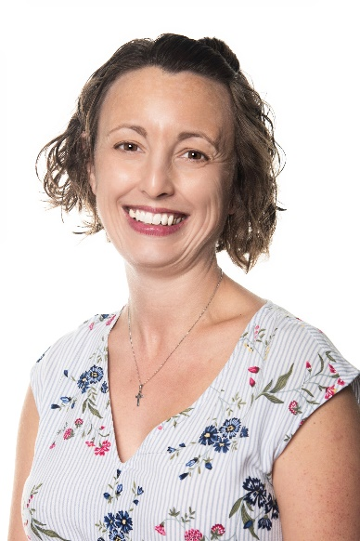

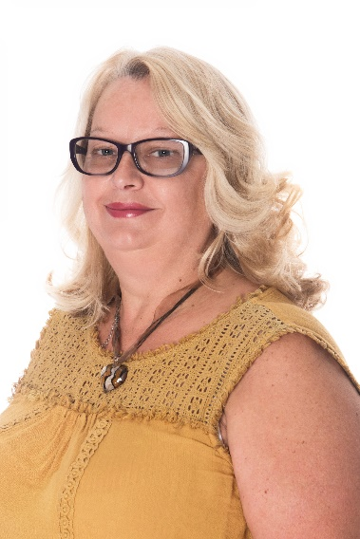
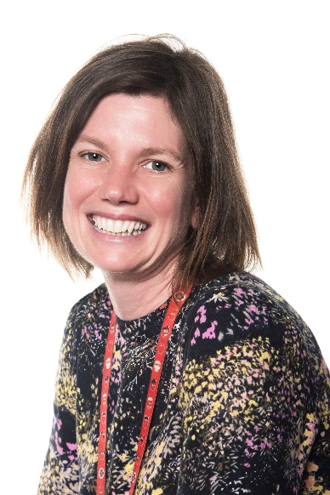
Meet the Team
  Mrs Naomi Burton Mrs Suzanne Hardy
Mrs Jackie Bucknall Mrs Rachel Offord
Notes:
Karl’s slide

Slide 7
The School Day
  The Early Years Foundation Stage (EYFS) – lots of similarities with nursery settings:
  Indoor and outdoor learning
  Small group work
  Whole class sessions
  Lunchtime
Notes:
Suzi

Slide 8
Summer Transition Arrangements
Lots of information available to parents – packs sent out; new starters page on website
Thank you for getting in touch already via the Microsoft form
School staff have been in contact with nursery settings
Children to visit school during the summer term
Family picnic hosted by Friends of Woodthorpe Infant School
Summer Challenge
Notes:
Suzi: We have lots of things planned to help make the transition into school as easy as possible for you and your child. You will have received a pack of information containing forms to be returned to school. Thank you to those of you who have returned these. Please make sure any outstanding forms are returned as soon as possible.
We have a page on the school website where we are posting further information including a video of the staff and other details about school life to share with your child.
Thank you too for those of you who completed our online form with details of your children and their friendships and needs. This really helps begin to get to know them. I have also contacted nurseries over the last few weeks to get further details about your child and how they are in their setting. All this information has been used to help create our classes.
Today (Shortly) you will have received a letter informing you of your child’s class and details of the transition sessions. Before they come for their first transition visit, we would like to meet them (and you!) virtually. This short online meeting with one of your child’s teachers will give you to chance to ask any questions/share any concerns you may have.
Our school parents association, The Friends of Woodthorpe are hosting a family picnic on the helicopter park before one of these transition sessions so you have a chance to meet other families starting school.
Summer Challenge – help your child to get to know our learning powers and develop some of the key skills and independence ready for starting school.

Slide 9
Summer Transition Days
19th June (am) stay and play with parents/carers – 45mins
19th June after both sessions, informal play/meet at the helicopter park for parents and children
26th June (am) stay and play without parents/carers – 1 hour (we invite parents and carers to settle your child first)
1st July (am) stay and play without parents/carers – 1 ½ hours
  This session will have all 30 children for 20 minutes during the session – please be patient when dropping off/collecting!
Notes:
NaomiWe have three Sumer Transition Days planned where the children will spend time in their classroom and get to know others in their class.
They have been planned to help your child become familiar with their new school and for us to get to know them and them to get to know us!
Transition from ‘stay n play’ to without parents. By third session, aim for them to stay whole session on own.
Picnic – if dry..
Last session – all 30 children.
Show booklet for transition.

Slide 10
September Transition Arrangements
Initial half days/sessions
Groups based on nursery groups/friendships
How to support if they have a wobble
Curriculum presentation to parents
Notes:
Naomi: In September, children will come into school for half day sessions in small groups which have been based around nursery groups and friendships. Please don’t worry if your child is coming and doesn’t know anyone else who is starting. They are not alone and will we be doing a lot of work on developing friendships over the first term. It won’t be long before they find a friend! Dates and times of these sessions are all in your packs that you have received tonight/posted out.
We know this is a huge change in your child’s life (and yours!). We also know how resilient and brave children are. Having been in touch with nurseries and child care settings over this past month, I also know how much they are doing to help your child prepare for this transition. There may well be some tears as you drop them off (and not just from the children!) but the best thing you can do for your child if they are upset is to be positive, give them a big hug and leave them with us. As you all know, the more you stay, the harder it can be – for you and them! Rest assured if they aren’t settling we will let you know but once the doors are shut, they have so much fun they hardly have time to think of home.
During the first month or so, we host a curriculum evening for parents to come into school and discover more about what your child will be learning over the year.

Slide 11
Day 1: Thursday 3rd September
Group 1
Arrive at 8.45am
Stay and settle your child in the classroom
Collection 11.30am
No lunch provided
Group 2
Arrive at 12.45pm
Stay and settle your child in the classroom
Collection 3.30pm
No lunch provided
Notes:
Naomi’s slide

Slide 12
Day 2: Friday 5th September
All children
Arrive at 8.45am
Lunch is provided
Collection 12.30pm
Day 3: Monday 8th September
All children
First full day in school, 8.45 – 3.30pm
Notes:
Naomi:All 30 children together – with lunch.
Try and leave them at the door – stay if they need you to…

Slide 13

What Your Child Needs
School Uniform
Bottle green polo shirt
Bottle green jumper/cardigan
Black/dark grey skirt, shorts, pinafore dress or trousers
Green and white checked dress for the summer
Sensible dark shoes
Children do not need a book bag for Reception.
www.just-schoolwear.co.uk or www.schoolwearsolutions.com
Notes:
Suzi slide

Slide 14

What Your Child Needs
PE Kit
White t-shirt
Black shorts
Plain, appropriate tracksuit or equivalent
Trainers
Drawstring bag
In September, children will come to school wearing their PE kit. Our PE day is Wednesday.
Notes:
Suzi slide

Slide 15

What Your Child Needs
Water Bottle
Please ensure this is labelled with your child’s name
Filled with water (not juice/flavoured water)
Access to water should they forget
Notes:
Suzi slide

Slide 16
How to Help Your Child Get Ready for School
Dressing and undressing
Toileting
Playing with other children – taking turns, sharing
Keep it positive – use the website photos and challenges to familiarise them with school
Listen to their worries and reassure them
Eye and hearing test
Notes:
Suzi slide

Slide 17

Parent Helpers
We welcome parents and grandparent to help in our classrooms.
If you can spare some time to listen to some readers or help with some gardening jobs, we would love to hear from you.
Please speak to your child’s class teacher.
Notes:
Naomi

Slide 18

Class Dojo
Children are awarded ‘Dojo points’, which are linked to our school’s ‘Learning Powers’.
The school has a News page that shares important information and reminders.
Each class has its own page, where photographs of activities in school are shared.
You can also directly message teachers with any non-urgent queries.
All urgent or attendance-related messages must be sent to the school office.
Notes:
Naomi

Slide 19

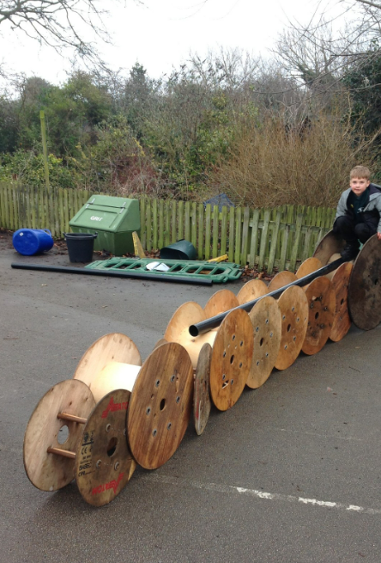
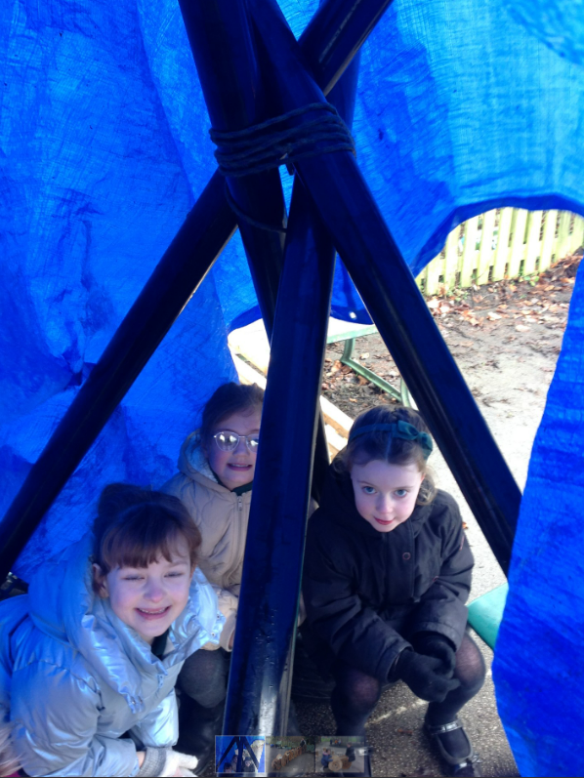
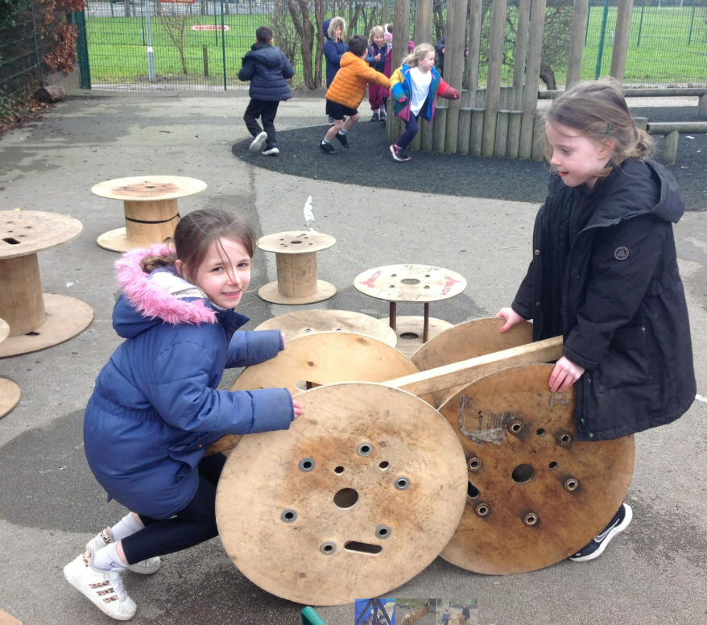

Slide 20

Friends of Woodthorpe
FOWI

Slide 21

What is FOWI?
We are the School's PTA
We organise events, raise money and help create memorable experiences for the children
But really...we're a group of parents, carers and staff trying to find original and creative ways to make school life even more magical.

Slide 22
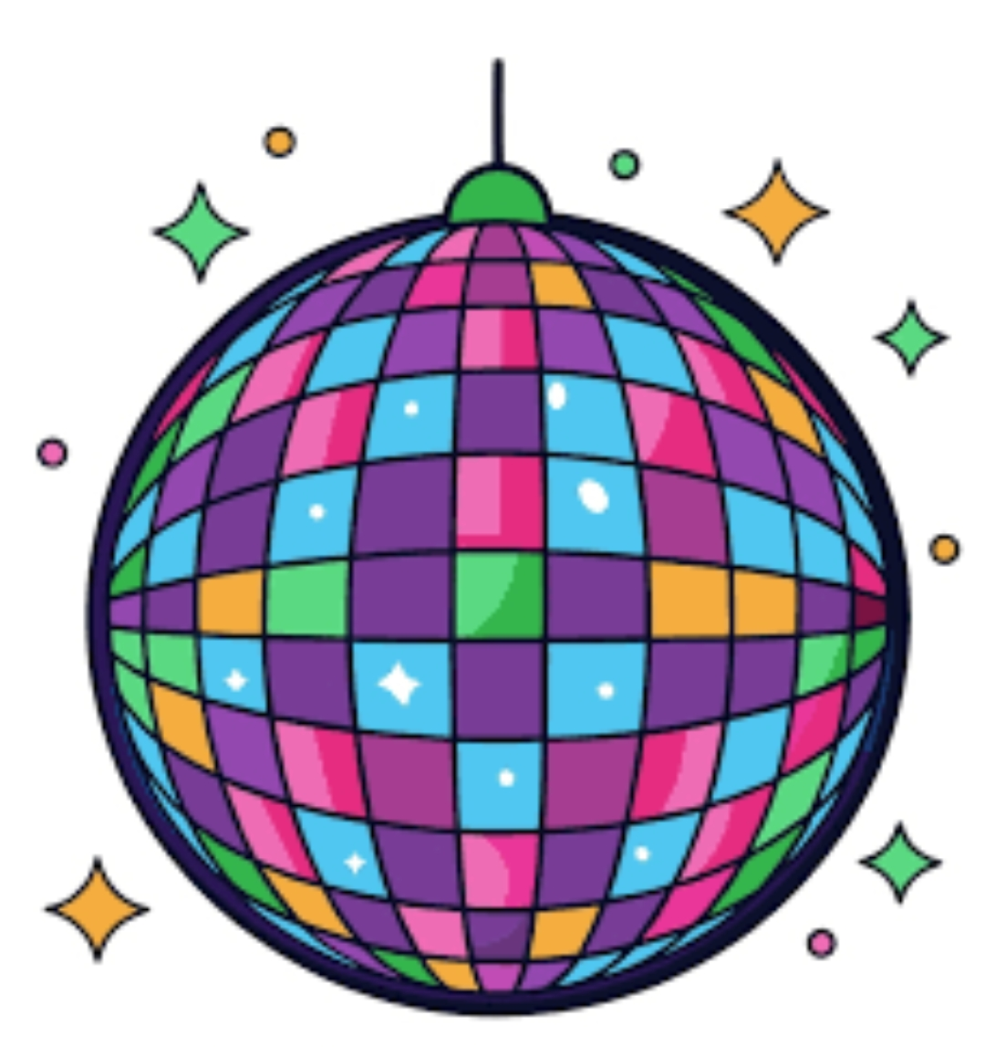



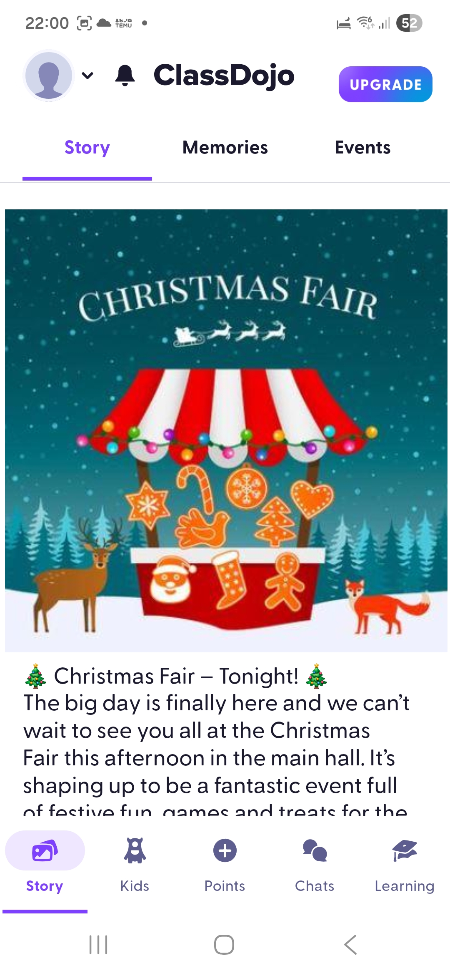
What do we do?
We organise:
Children's Discos
Non-Uniform Days
  Wear a Colour Day, Make the Rules Day, Bring a Bottle Day
Christmas Fair & Santa's Grotto
Children's Christmas Cards
Christmas Tree Sales
Easter Decorating Competitions / Egg and Spoon Races
Frozen Fridays
Summer Fair
Family Summer Disco

Slide 23
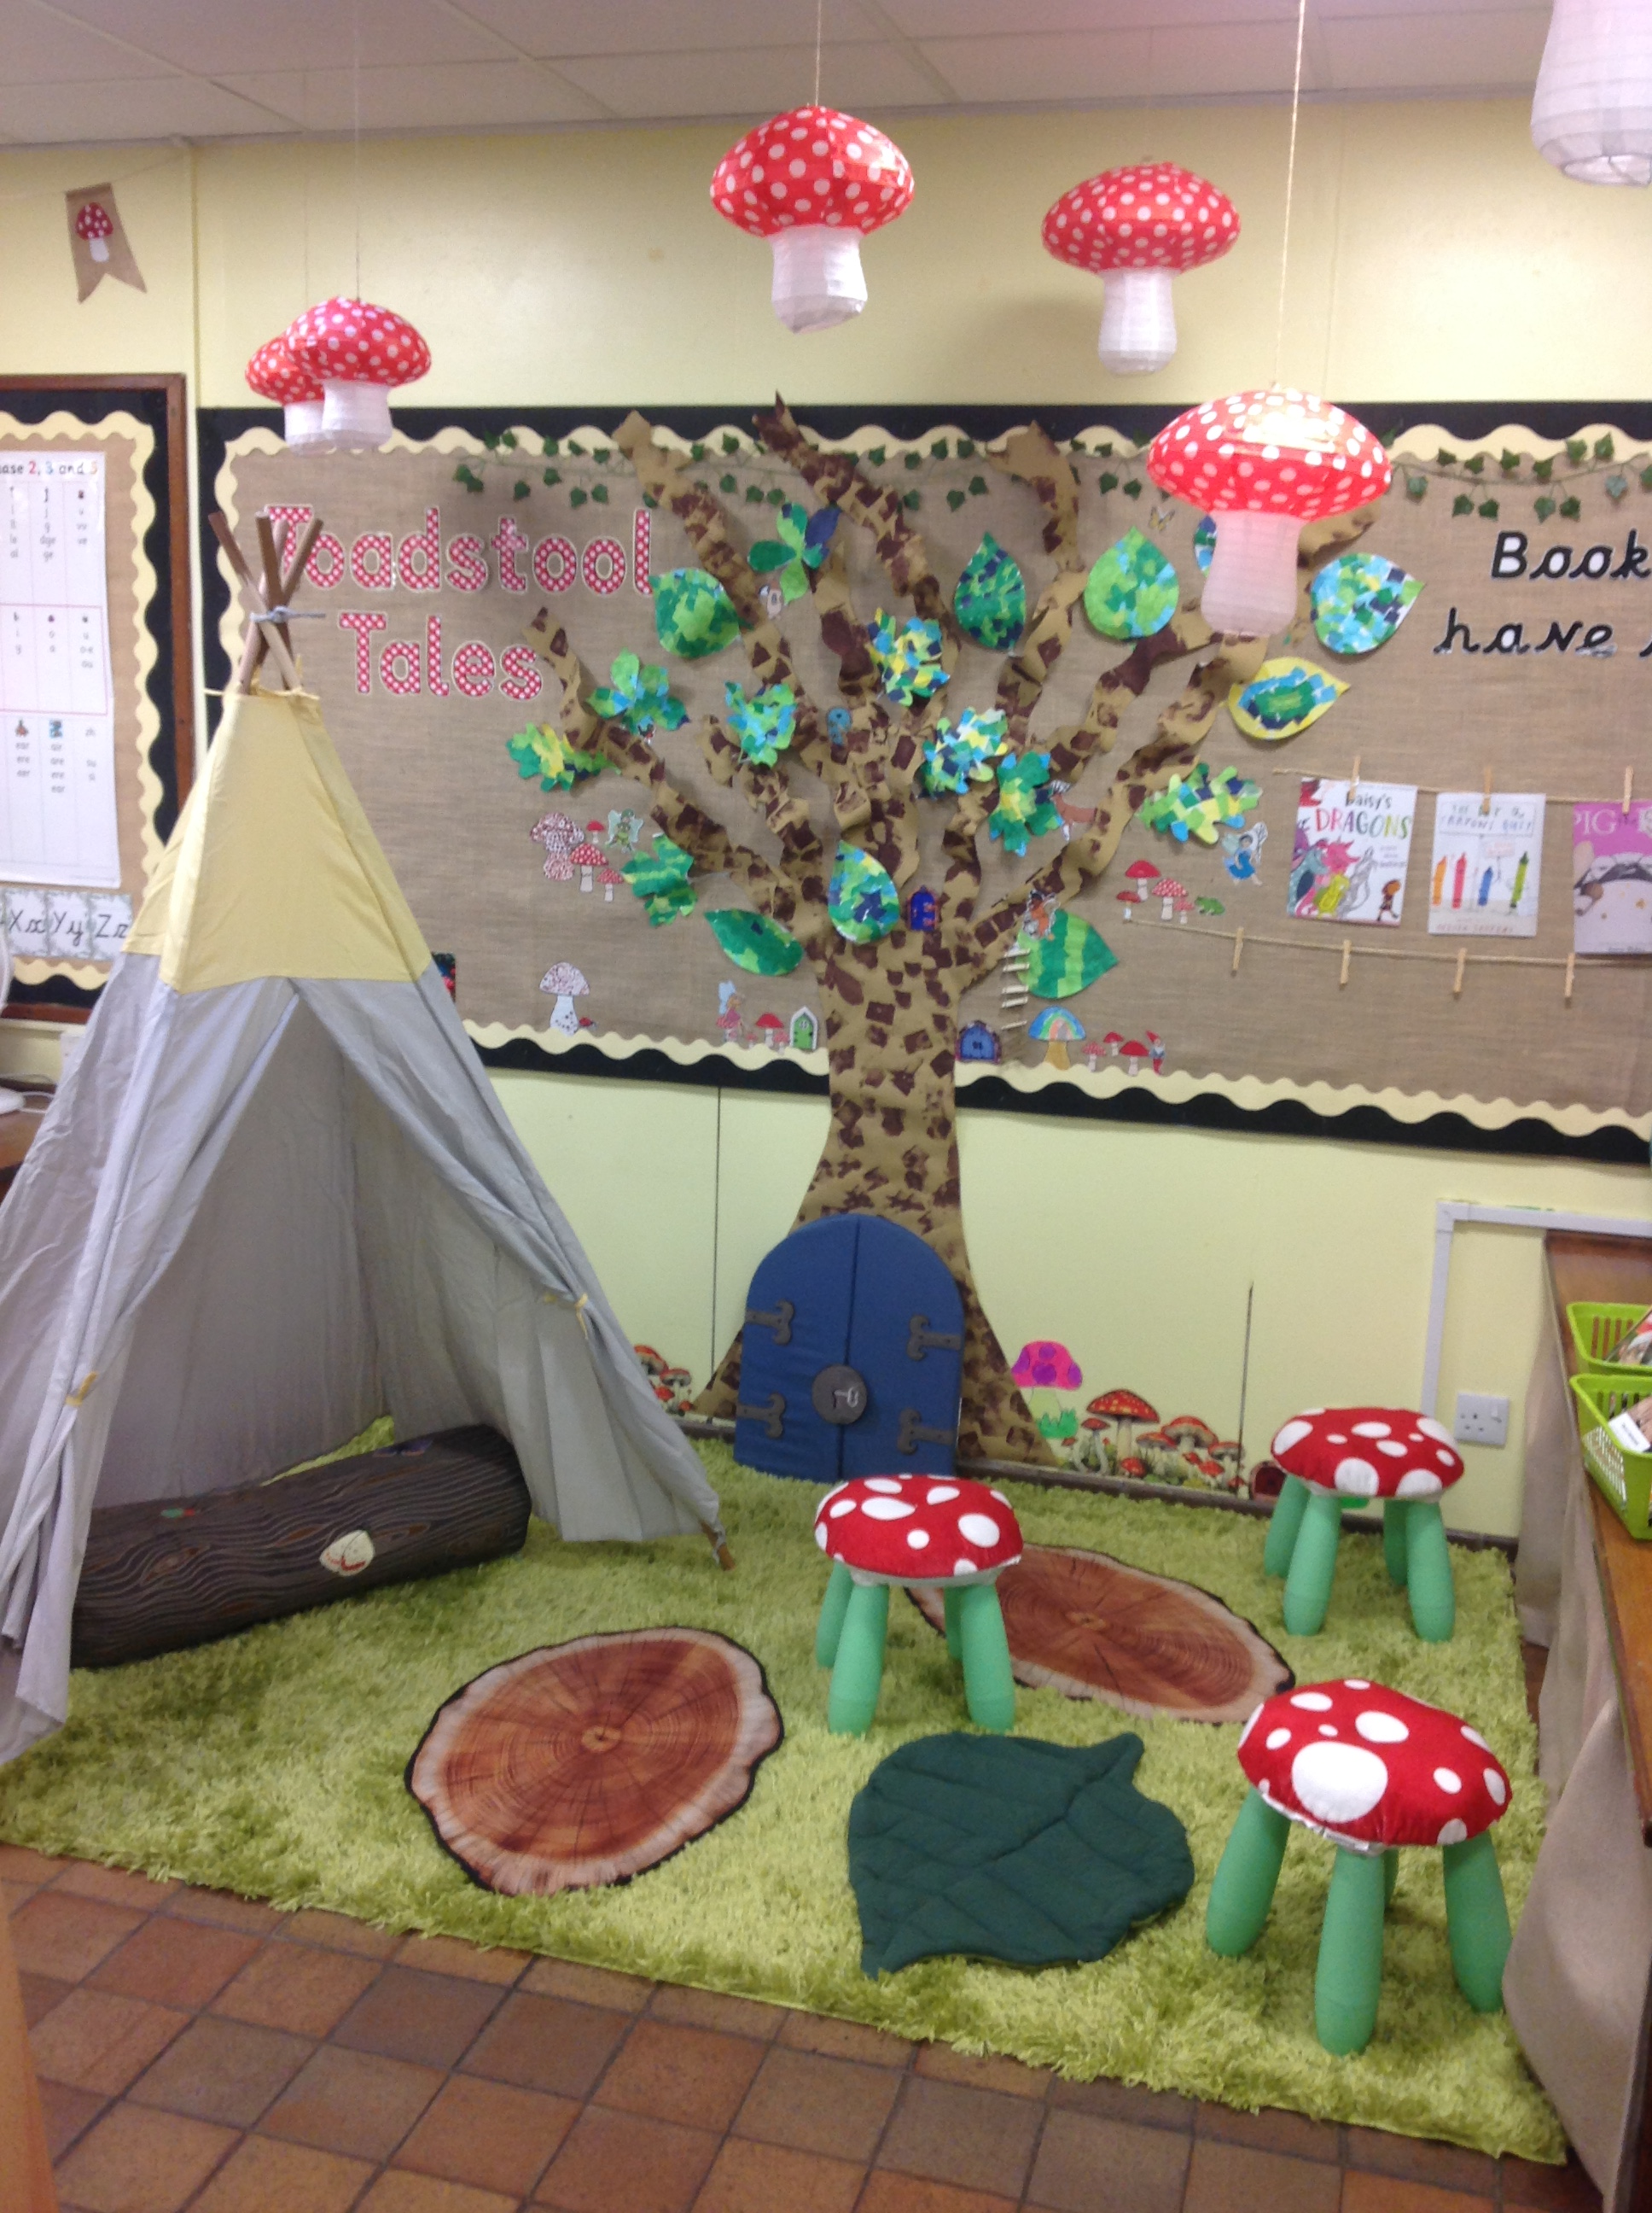
Where does the money go?
Classroom Provisions
A budget for each class, supporting tailored learning resources
Support for classroom reading corners
Tablets for each class teacher (to support Class Dojo)
Whole School Support
School sports kit
A book from Santa for each child
Whole school productions, workshops and year group trips
Year 2 leavers Event
Playground Support
Supporting with the purchase of outdoor equipment
Playground enhancements

Slide 24

How you can help
You absolutely do NOT need loads of spare time..
A range of ways you can support
Every little bit helps
For more info come and say hello
Show your interest –Scan the QR code

Slide 25

We look forward to getting to know you and your child.
Any questions?

